Slide 1
Abstract Factory Pattern
Ms. Shehla Saeed

Slide 2
Abstract Factory Pattern
Abstract Factory design pattern is one of the Creational pattern.
Abstract Factory pattern is almost similar to Factory Pattern is considered as another layer of abstraction over factory pattern.
Abstract Factory patterns work around a super-factory which creates other factories.

Slide 3
Advantage and Usage
To Hide Complex Details: It separates your main program (the client) from the complicated code used to actually build the objects. Your system doesn't need to know how things are created.
To Keep Families Together: It ensures that objects designed to work together are always used together. It prevents you from accidentally mixing parts from different families.
To Allow Easy Swapping: It lets you easily configure a system to switch between completely different sets of objects with minimal code changes.
To Provide a Clean Toolbox: It lets you share a library of objects where other developers only see the basic controls (interfaces) and none of the messy internal code (implementations).
Notes:
Key Exam Points
Keeping Families Together (Furniture Set): Think of buying furniture. If you select the "Modern" factory, you are guaranteed to get a modern chair, a modern table, and a modern sofa. The pattern prevents you from accidentally pairing a sleek modern chair with a bulky Victorian table!
Easy Swapping (Light/Dark Mode): Think about changing a software app from "Light Mode" to "Dark Mode." By simply switching the factory from LightUIFactory to DarkUIFactory, every single button, text box, and background automatically updates to the new, matching family without you having to change the code for each individual item.
Client is independent of object creation
Supports loose coupling
Easy to add new families of products
Follows Open/Closed Principle

Slide 4
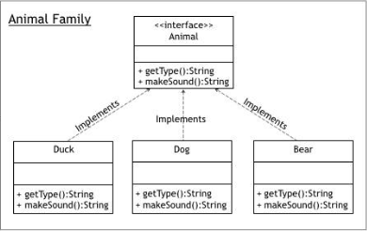






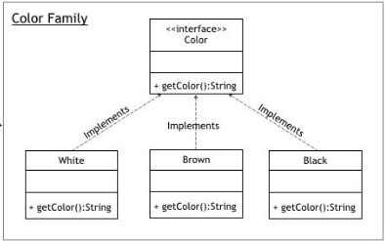


Notes:
Abstract Factory defines an interface for creating families of related objects,
while Factory Provider is responsible for selecting and returning the appropriate factory based on client input.
Simple Analogy
Think of a Mall
Factory Provider = Reception Desk Tells you which shop to go to
Abstract Factory = Shop Gives you the product
Product = Item you buy

Slide 5
Elements of Abstract Factory Pattern
AbstractFactory (The Master Blueprint)
What it is: The top-level interface or general rulebook.
What it does: It tells the system how to make a group of related factories. The user (client) only interacts with this blueprint, which hides the messy, behind-the-scenes details of how things are actually built.
Notes:
AbstractFactory (Main Factory Interface)
👉 What it is: A blueprint for factories
👉 Simple idea: It tells what a factory can create, but not how
👉 example:
abstract class AbstractFactory { abstract Bank getBank(String bank); abstract Loan getLoan(String loan); }
In simple words:
“Any factory must be able to create Bank or Loan objects”

Slide 6
ConcreteFactory (The Specific Builder)
What it is: The actual, working factory (a specific version of the master blueprint).
What it does: It does the real heavy lifting. It contains the exact code to build the actual, specific products.
Notes:
What it is: Actual factories that create real objects
example:
BankFactory
LoanFactory
“This factory knows HOW to create specific objects”

Slide 7
AbstractProduct (The General Item Category)
What it is: A broad category describing what a specific item should be.
What it does: It defines the basic rules for a product. When you ask the factory for this item, it guarantees you get the exact version that perfectly matches the specific ConcreteFactory you are currently using.
Notes:
What it is: A common interface for products
example:
Bank
Loan
Example:

Slide 8
ConcreteProduct (The Final Item)
What it is: The actual, finished object created by the specific factory.
What it does: It contains the real, working code for that specific item.
It is the tangible result that fulfills all the rules laid out by the generic AbstractProduct category.
Notes:
What it is: Actual objects created by factories
Examples:
ICIC, HBFC → Bank products
HomeLoan, BusinessLoan → Loan products

Slide 9
Client (The User or System)
What it is: The part of your program that actually needs to use these items.
What it does: It only interacts with the generic blueprints (AbstractFactory and AbstractProduct).
Because of this, the Client is "blissfully ignorant"—it doesn't know or care how the objects are built or what specific class they belong to.
It just asks for an item and trusts the system to hand it the right one.

Slide 10
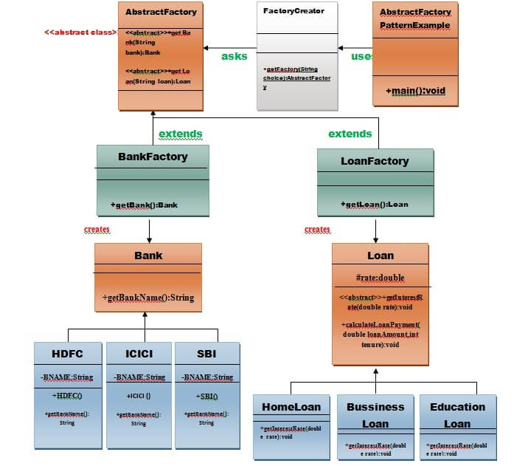

Slide 11
Example of Abstract Factory Pattern
Here, we are calculating the loan payment for different banks like HDFC, ICICI, SBI etc.
Step 1: Create a Bank interface
import java.io.*;
interface Bank
{
String getBankName();
}

Slide 12
Step 2:
class HDFC implements Bank { private final String BNAME = "HDFC BANK"; @Override public String getBankName() { return BNAME; } }

Slide 13
Step 2:
class ICICI implements Bank { private final String BNAME = "ICICI BANK"; @Override public String getBankName() { return BNAME; } }

Slide 14
Step 2:
class SBI implements Bank { private final String BNAME = "SBI BANK"; @Override public String getBankName() { return BNAME; } }

Slide 15
Step 3: Create the Loan abstract class.
abstract class Loan { protected double rate; abstract void getInterestRate(double rate); public void calculateLoanPayment(double loanAmount, int years) { int n = years * 12; double monthlyRate = rate / 1200; double EMI = (monthlyRate * Math.pow(1 + monthlyRate, n)) / (Math.pow(1 + monthlyRate, n) - 1) * loanAmount; System.out.println("Monthly EMI: " + EMI + " for loan amount: " + loanAmount); } }

Slide 16
Step 4: Create concrete classes that extend the Loan abstract class..
class HomeLoan extends Loan { @Override void getInterestRate(double r) { rate = r; } } class BusinessLoan extends Loan { @Override void getInterestRate(double r) { rate = r; } } class EducationLoan extends Loan { @Override void getInterestRate(double r) { rate = r; } }

Slide 17
Step 5:
Create an abstract class (i.e AbstractFactory) to get the factories for Bank and Loan Objects.
abstract class AbstractFactory{
public abstract Bank getBank(String bank);
public abstract Loan getLoan(String loan);
}

Slide 18
Step 6:
Create the factory classes that inherit AbstractFactory class to generate the object of concrete class based on given information.
class BankFactory extends AbstractFactory {
@Override
public Bank getBank(String bank) {
if (bank == null) {
throw new IllegalArgumentException("Bank type cannot be null");
}
switch (bank.toLowerCase()) {
case "hdfc":
return new HDFC();
case "icici":
return new ICICI();
case "sbi":
return new SBI();
default:
throw new IllegalArgumentException("Unknown bank type: " + bank);
}
}
@Override
public Loan getLoan(String loan) {
// BankFactory does NOT create Loan objects
throw new UnsupportedOperationException("BankFactory cannot create Loan objects");
}
}

Slide 19
Step 6:
class LoanFactory extends AbstractFactory { @Override public Bank getBank(String bank) { throw new UnsupportedOperationException("LoanFactory cannot create Bank"); } @Override public Loan getLoan(String loan) { if (loan == null) { throw new IllegalArgumentException("Loan type cannot be null"); } switch (loan.toLowerCase()) { case "home": return new HomeLoan(); case "business": return new BusinessLoan(); case "education": return new EducationLoan(); default: throw new IllegalArgumentException("Invalid Loan Type: " + loan); } } }

Slide 20
Step 7:
Create a FactoryCreator class to get the factories by passing an information such as Bank or Loan.
class FactoryCreator
{ public static final String BANK = "bank"; public static final String LOAN = "loan"; public static AbstractFactory getFactory(String choice)
{ if (choice == null)
{ throw new IllegalArgumentException("Factory type cannot be null"); } switch (choice.toLowerCase())
{ case BANK: return new BankFactory(); case LOAN: return new LoanFactory(); default: throw new IllegalArgumentException("Unknown factory type: " + choice); } } }

Slide 21
Step 8:
Use the FactoryCreator to get AbstractFactory in order to get factories of concrete classes by passing an information such as type.
import java.util.Scanner; class AbstractFactoryPatternExample
{ public static void main(String[] args)
{ Scanner sc = new Scanner(System.in); System.out.print("Bank: "); String bankName = sc.nextLine(); System.out.print("Loan Type: "); String loanName = sc.nextLine(); System.out.print("Rate: "); double rate = sc.nextDouble();

Slide 22
Step 8
System.out.print("Amount: "); double amount = sc.nextDouble(); System.out.print("Years: "); int years = sc.nextInt(); Bank bank = FactoryCreator.getFactory("Bank").getBank(bankName); Loan loan = FactoryCreator.getFactory("Loan").getLoan(loanName); System.out.println("\nLoan from: " + bank.getBankName()); loan.getInterestRate(rate); loan.calculateLoanPayment(amount, years); } }

Slide 23
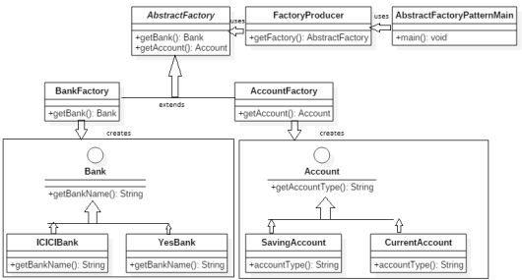
Notes:
Bank & Account Abstract Factory
Classes Involved:
BankFactory and AccountFactory: Abstract factories
Bank and Account: Abstract products
ICICIBank, YesBank: Concrete products of Bank
SavingAccount, CurrentAccount: Concrete products of Account
How it works:
BankFactory has a method getBankName() that returns a Bank object.
AccountFactory has a method getAccount() that returns an Account object. Depending on which factory is used, the correct bank or account object is created (e.g., ICICIBank or SavingAccount).
Goal: To create families of related or dependent objects (banks and accounts) without specifying their concrete classes.

Slide 24
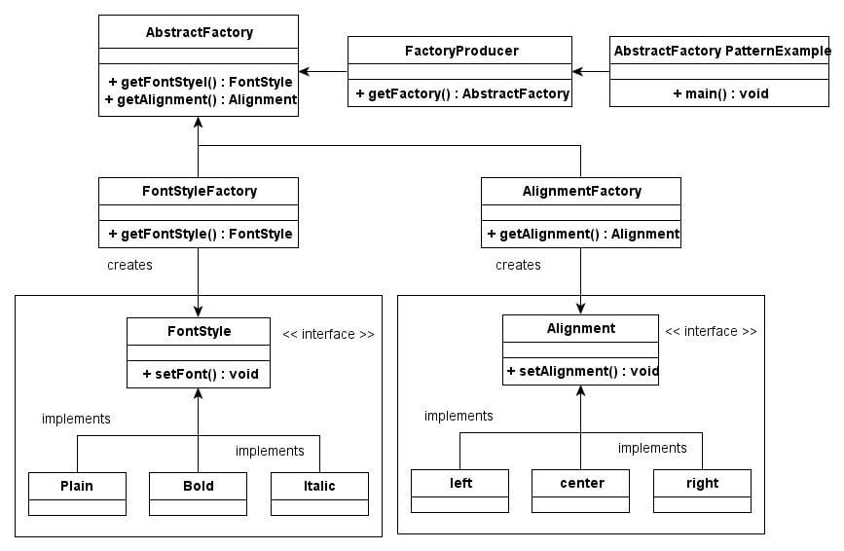
Notes:
Font Style & Alignment Abstract Factory
Classes Involved:
AbstractFactory: Defines getFontStyle() and getAlignment().
FactoryProducer: Decides which factory to return.
FontStyleFactory and AlignmentFactory: Concrete factories
FontStyle, Alignment: Interfaces for products
Plain, Bold, Italic: Concrete font styles
left, center, right: Concrete alignments
How it works:
FactoryProducer provides the right factory (either for font or alignment).
FontStyleFactory creates objects like Plain, Bold, etc.
AlignmentFactory creates left, center, or right alignments.
Goal: To demonstrate that multiple related object families (font + alignment) can be created without depending on concrete classes.

Slide 25
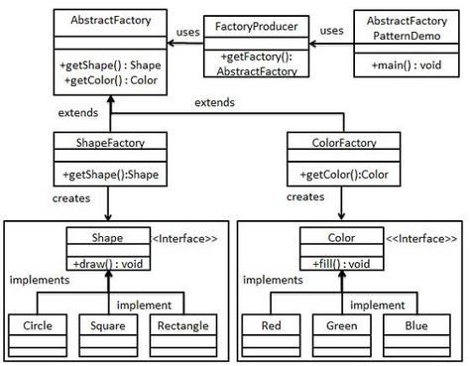
Notes:
Shape & Color Abstract Factory
Classes Involved:
AbstractFactory: Has methods getShape() and getColor().
FactoryProducer: Returns the correct factory based on need.
ShapeFactory and ColorFactory: Concrete factories
Shape and Color: Interfaces for products
Implementations (not shown in detail): likely Circle, Square for Shape; Red, Blue for Color.
How it works:
FactoryProducer is asked for either a shape or color factory.
ShapeFactory can return a Shape object with a draw() method.
ColorFactory can return a Color object with a fill() method.
Goal: Create UI objects (shapes, colors) independently but using a unified factory interface.

